Slide 1

Basic Details of the Team and Problem Statement
MINISTRY/ORGANIZATION NAME/STUDENT INNOVATION: GOVERNMENT OF GUJARAT
PS CODE: SIH1364
PROBLEM STATEMENT TITLE:
FAKE SOCIAL MEDIA PROFILE DETECTION AND REPORTING
TEAM NAME: HACKTIVE ARCHITECTS
TEAM LEADER NAME: PRAJAPATI DIVYA RAMGOPAL
INSTITUTE CODE (AISHE): U-0136
INSTITUTE NAME: SCHOOL OF EMERGING SCIENCE AND TECHNOLOGY ( GUJARAT UNIVERSITY)
THEME NAME: BLOCKCHAIN AND CYBERSECURITY

Slide 2
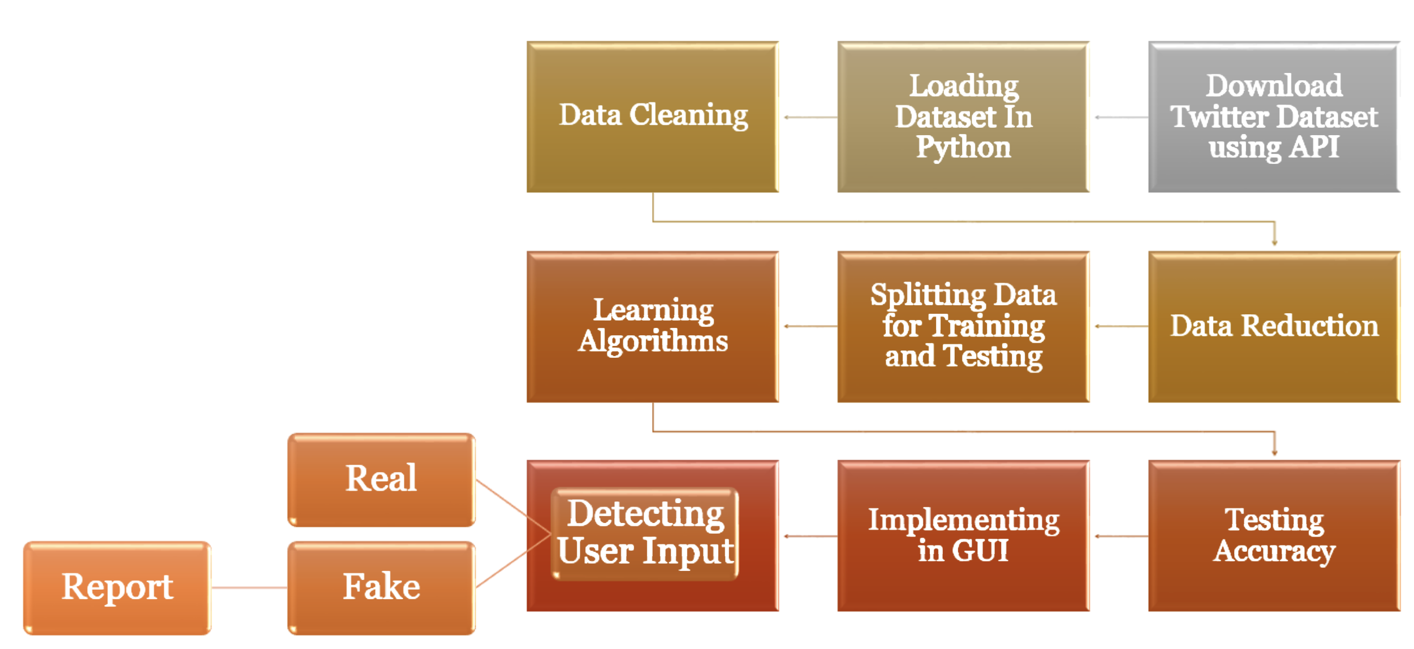
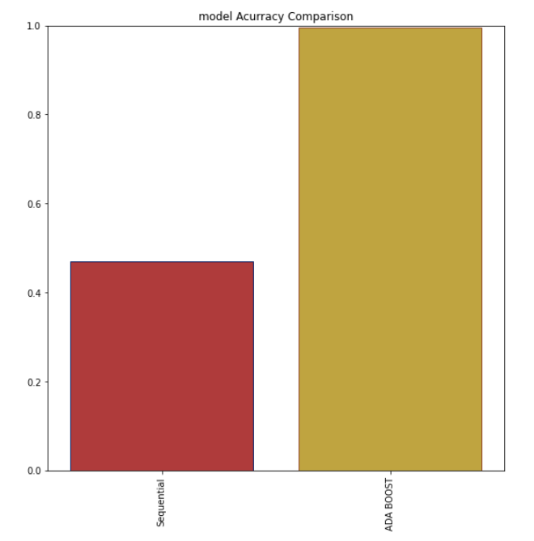
IDEA/APPROACH DETAILS:
IDEA : Our idea is to develop a robust system for the detection and reporting of fake social media profiles across various platforms, such as Twitter, Facebook, and Instagram. The goal is to create a user-friendly and efficient solution that empowers users to identify and report suspicious profiles, helping maintain the integrity and trustworthiness of social media networks.
SOLUTION: FAKE SOCIAL MEDIA PROFILE DETECTION WITH KERAS SEQUENTIAL AND ADABOOST.
Data Collection And Preprocessing
Feature Extraction
Keras Sequential Model
Adaboost Classifier
Ensemble Model
Optimizing
Evaluation And Validation
Deployment And Reporting
Continuous Improvement
STACK CHART
MODEL ACCURACY
PROTOTYPE :
Our prototype will focus on the development of a web-based interface for reporting and analyzing fake social media profiles.
An automated analysis module that processes reported profiles using initial machine learning/deep learning models and NLP techniques.
The prototype will be tested using simulated fake profiles and real user reports to refine our algorithms. We will work towards a fully functional solution that enhances the security and trustworthiness of social media platforms while respecting user privacy.

Slide 3
Idea/Approach Details:
Use cases:
Some potential use cases for fake social media profile detection and reporting using Keras Sequential and AdaBoost classifiers, with a focus on precision value and accuracy as key performance metrics.
DEPENDENCIES:
Python And Libraires
Data
Computation Resources
Model Development
Hyperparameter Tuning
Ethical Consideration
User Interface
Evaluation Metrics
POTENTIAL SHOWSTOPPERS:
Data Quality
Data Privacy
Model Overfitting
Scalability
False Positive And Negatives
Algorithm Complexity
Feedback Loop
Model Interpretability
Resource Constraints
Regulatory Compliance
Algorithm Fairness
Addressing these dependencies and mitigating the
Potential showstoppers will be critical for the successful
development and deployment of a fake social media
profile detection and reporting system using Keras
Sequential and AdaBoost.
Objective: To enhance the security and trustworthiness of a social media platform by automatically detecting and reporting fake profiles.
Implementation: Develop a system that integrates with the social media platform's reporting system.
Users can report suspicious profiles, and the system analyzes these reports.
The combined Keras Sequential and AdaBoost model is used to verify reported profiles.
Precision: High precision is crucial to avoid false accusations and maintain user trust.
Accuracy: Accurate detection of fake profiles ensures a safer platform.
Using keras sequential :47.5%
Using Adaboost classifier:99.50%

Slide 4
Team Member Details
Team Leader Name: PRAJAPATI DIVYA RAMGOPAL
Branch :M.sc Stream :APPLIED MATHEMATICAL SCIENCE Year (I,II,III,IV): II
Team Member 1 Name: PNKU YADAV
Branch: M.sc Stream : APPLIED MATHEMATICAL SCIENCE Year (I,II,III,IV): II
Team Member 2 Name: PATEL MITUL SHAILESHBHAI
Branch :M.sc(integrated) Stream :DATA SCIENCE Year (I,II,III,IV): I
Team Member 3 Name: AMISHA ROHIT
Branch : M.sc Stream : APPLIED MATHEMATICAL SCIENCE Year (I,II,III,IV): II
Team Member 4 Name: PATEL JANVIBAHEN BHUPENDRAKUMAR
Branch : M.sc Stream : APPLIED MATHEMATICAL SCIENCE Year (I,II,III,IV): II
Team Member 5 Name: CHAUHAN MITTAL PRAVINBHAI
Branch : M.sc Stream : APPLIED MATHEMATICAL SCIENCE Year (I,II,III,IV):II
Team Mentor 1 Name: Type Your Name Here
Category (Academic/Industry): SAURABH DAS Expertise :AI/ML Domain Experience (in years): 2 yrs.

